Slide 1

LOGISTIC REGRESSION- DEFAULT ON PAYMENT CASE STUDY
BY TANIA DAS

Slide 2
DATASET AND TASK
About The Data : The dataset is a Default On Payment dataset and it has 5000 rows and 23 columns. The columns are:
Customer_ID ,Status_Checking_Acc ,Duration_in_Months ,Credit_History ,Purposre_Credit_Taken ,Credit_Amount Savings_Acc ,Years_At_Present_Employment, Inst_Rt_Income ,Marital_Status_Gender ,Other_Debtors_Guarantors, Current_Address_Yrs, Property ,Age ,Other_Inst_Plans , Housing ,Num_CC ,Job Dependents ,Telephone Foreign_Worker ,Default_On_Payment ,Count
Categorical variable here is Default_On_Payment
Task: For the given data, build a Logistic Regression model to find out the key variables which significantly
explains the probability of ‘Default_On_Payment’. The Business Context of the question is as follows:
‘The client, a financial service institution, want to increase revenue streams and intents to target a
segment of their customers who are most likely to default on the loans/Credit taken.’
Here, the dependent variable is ‘Default On Payment’ where 1 = Customers are most likely to make default on loans and 0 = Customers are not likely to make default on the loans.
I will perform the task with the help of Logistic Regression Technique

Slide 3
WHY LOGISTIC REGRESSSION
In the particular dataset the dependent variable is categorical in nature and not continuous like in the case of linear regression problems.
In the Default On Payment classification problem, Y can take only two possible values: 0 or, 1; where 0 indicates False and 1 indicates True . Y, here is binary in nature .
Instead of trying to predict the dependent variable(Y), we try to predict the probability of the dependent variable as per the independent variables and also to get the model coefficients.

Slide 4
LOGISTIC REGRESSION:CONCEPT
What is Logistic Regression?
Logistic Regression is a “Supervised machine learning” algorithm that can be used to model the probability of a certain class or event. It is used when the data is linearly separable and the outcome is binary or dichotomous in nature. That means Logistic regression is usually used for Binary classification problems.
Binary Classification refers to predicting the output variable that is discrete in two classes.
A few examples of Binary classification are Yes/No, Pass/Fail, Win/Lose, Cancerous/Non-cancerous, etc.
Types of Logistic Regression:
Simple Logistic Regression: a single independent is used to predict the output
Multiple logistic regression: multiple independent variables are used to predict the output
Extensions of Logistic Regression
Although it is said Logistic regression is used for Binary Classification, it can be extended to solve multiclass classification problems.
Multinomial Logistic Regression: The output variable is discrete in three or more classes with no natural ordering. E.g:- Food texture: Crunchy, Mushy, Crispy
Ordered Logistic Regression: The output variable is discrete in three or more classes with the ordering of the levels.
E.g:-Income level: low income, middle income, high income

Slide 5
LOGISTIC REGRESSION:FUNCTIONAL FORM
The logistic regression equation is quite similar to the linear regression model.
Consider we have a model with one predictor “x” and one Bernoulli response variable “ŷ” and p is the probability of ŷ=1. The linear equation can be written as:
p = b0+b1x --------> eq 1
The right-hand side of the equation (b0+b1x) is a linear equation and can hold values that exceed the range (0,1). But we know probability will always be in the range of (0,1).
To overcome that, we predict odds instead of probability.
Odds: The ratio of the probability of an event occurring to the probability of an event not occurring.
Odds = p/(1-p)
The equation 1 can be re-written as:
p/(1-p) = b0+b1x --------> eq 2
Odds can only be a positive value, to tackle the negative numbers, we predict the logarithm of odds.

Slide 6
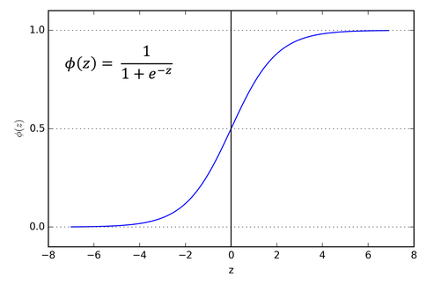
LOGISTIC REGRESSION:FUNCTIONALFORM
Log of odds = ln(p/(1-p))
The equation 2 can be re-written as:
ln(p/(1-p)) = b0+b1x --------> eq 3
To recover p from equation 3, we apply exponential on both sides.
exp(ln(p/(1-p))) = exp(b0+b1x)
e(ln(p/(1-p))) = e(b0+b1x)
From the inverse rule of logarithms,
p/(1-p) = e(b0+b1x) Simple algebraic manipulations
p = (1-p) * e(b0+b1x)
p = e(b0+b1x)- p * e(b0+b1x)
Taking p as common on the right-hand side
p = p * ((e(b0+b1x))/p - e(b0+b1x))
p = e(b0+b1x) / (1 + e(b0+b1x))
Dividing numerator and denominator by e(b0+b1x) on the right-hand side
p = 1 / (1 + e-(b0+b1x))

Slide 7
LOGISTIC REGRESSION METHODOLOGY-MLE
MAXIMUM LIKELIHOOD ESTIMATION TECHNIQUE(MLE)
Estimation of parameters in logistic regression is carried out using MLE.
MLE is a statistical model for estimating model parameter of a function.
For a given dataset, the MLE chooses the values of model parameters that makes the data “more likely”, than other parameter values.

Slide 8
PREDICT CUSTOMERS WHO ARE MOST LIKELY TO DEFAULT ON LOAN/CREDIT TAKEN
Approach Required:
1. Business & Analytical Solution: Prepare a slide on the business solution, which takes into
account the business context.
2. Hypothesis formulation: Frame a hypothesis table, and put down the hypothesis of
independent variable wrt dependent variable.
3. Data treatment: Missing Values Treatment
4. Data Exploration
5. Splitting the data into train and test data
6. Model Building and Refinement: Train Data
7. Model Building and Refinement: Test Data

Slide 9
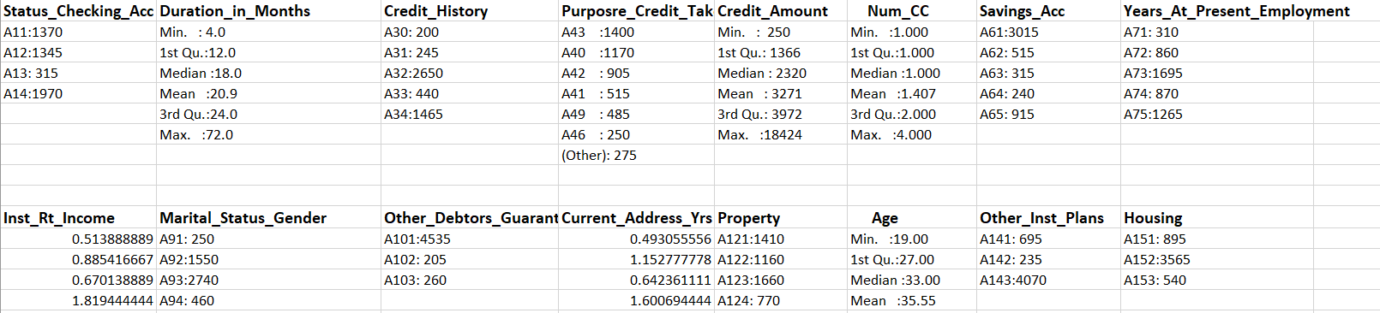
EXPLORATION OF THE DATA
SUMMARY OF ALL THE VARIABLES

Slide 10
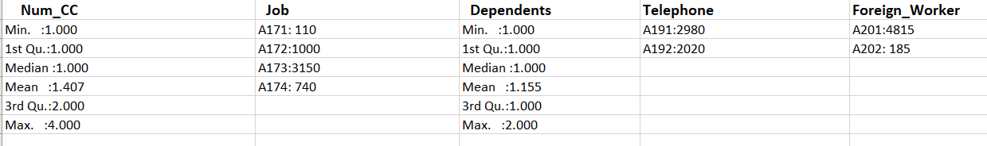
EXPLORATION OF THE DATA
SUMMARY OF ALL THE VARIABLES
In the given dataset the variable Default_on_Payment is the dependent variable where the no of customers who are most likely to make default on loans =1495 and no of customers who are not likely to make default on the loans.=3505

Slide 11
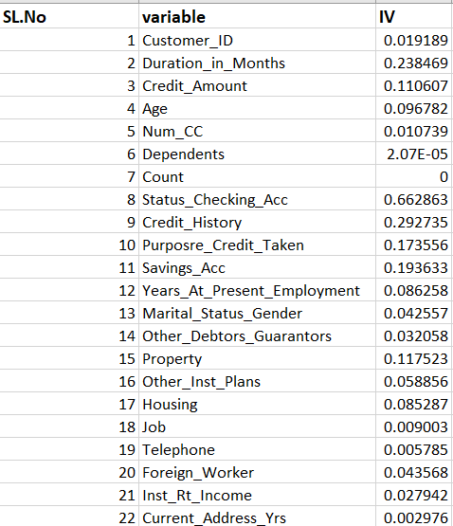
EXPLORATION OF THE DATA
INFORMATION VALUE OF ALL THE VARIABLES
According to Siddiqi (2006), by convention the values of the IV statistic can be interpreted as follows.
If the IV statistic is:
Less than 0.02, then the predicter is not useful for modeling (separating the Goods from the Bads)
0.02 to 0.1, then the predictor has only a weak relationship to the Goods/Bads odds ratio
0.1 to 0.3, then the predictor has a medium strength relationship to the Goods/Bads odds ratio
0.3 or higher, then the predictor has a strong relationship to the Goods/Bads odds ratio.

Slide 12
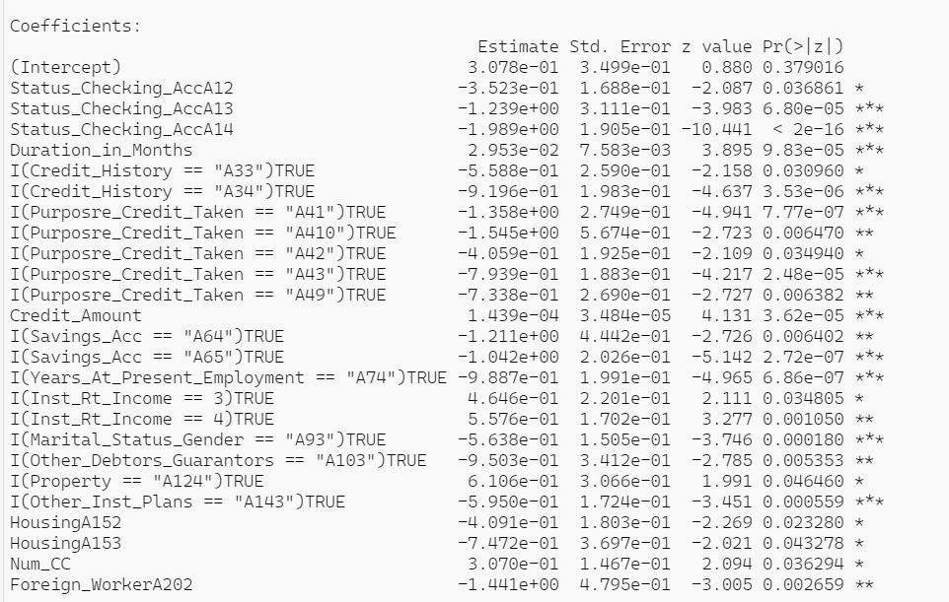
BUILDING THE MODEL
The entire dataset is split into train
and test dataset in he ratio of 70:30.
The train dataset has 3500 rows
and test dataset has 1500 rows.
In order to build the training model
we removed the insignificant
variables one by one on the basis
of high p-value and vif.
Finally after removing the
insignificant variables and after
validating the training model on test
data we were left with 26 significant
variables

Slide 13
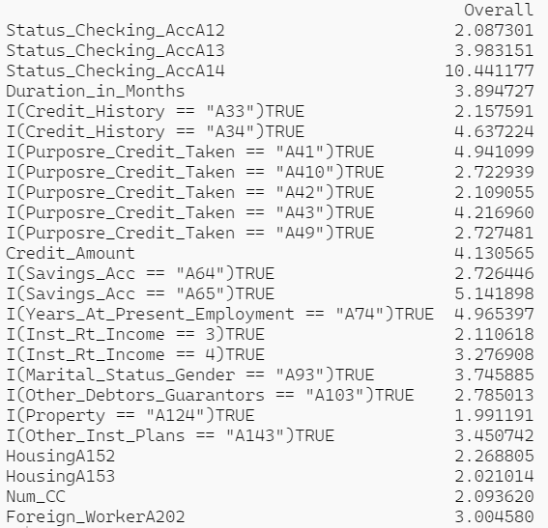
BUILDING THE MODEL
Variable Importance
Importance of variables in the final model is given in the image
Status_Checking_AccA14 is the variable with highest overall importance 10.441177 followed by Savings_Acc A65 with importance of 5.141898.
Variable with lowest importance value of 1.99 is Property A124.

Slide 14
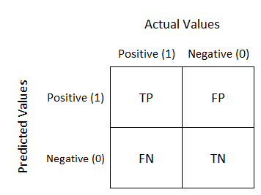
MODEL DIAGNOSTICS
Confusion Matrix is a tabulation for the predicted and actual value counts for each class. For a binary classification model like this one, where we are predicting one of the two possible values, the confusion matrix is 2x2 grid showing the predicted and actual value counts for classes 0 and 1.
A true positive is an outcome where the model correctly predicts the positive class. Similarly, a true negative is an outcome where the model correctly predicts the negative class.
A false positive is an outcome where the model incorrectly predicts the positive class. And a false negative is an outcome where the model incorrectly predicts the negative class.
TN= 734
FP=317
FN=81
TP=368

Slide 15
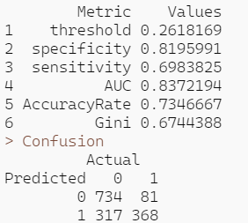
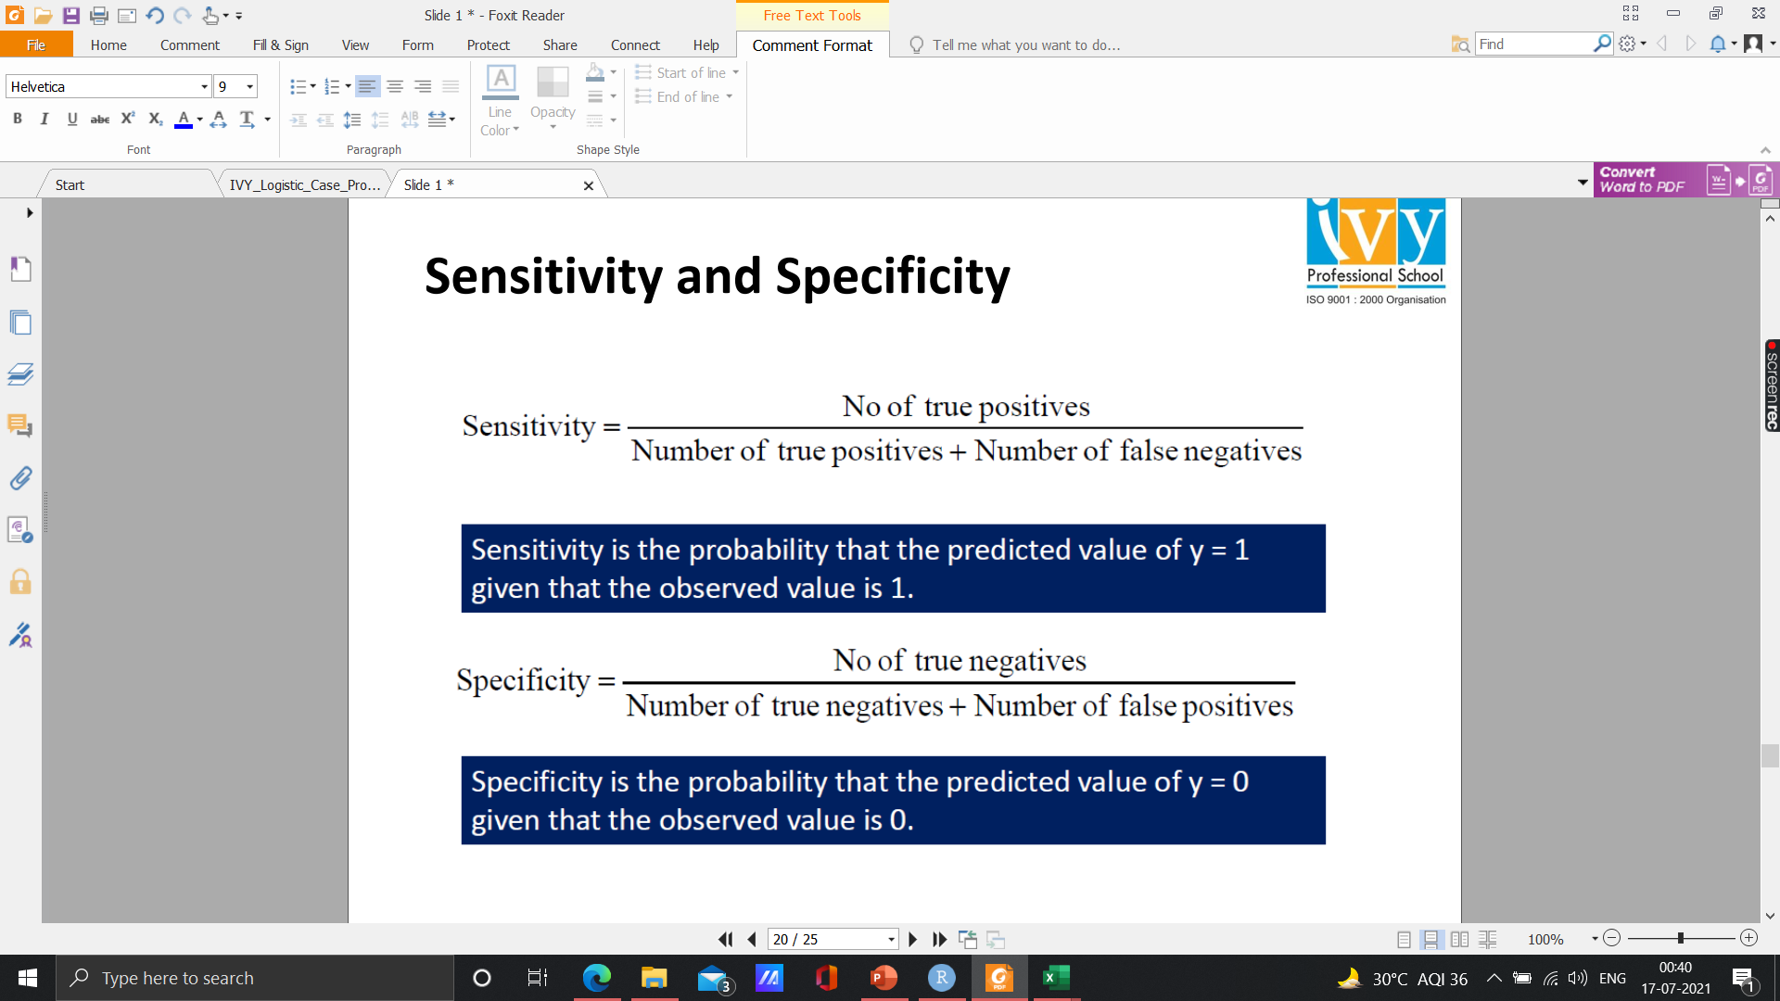
MODEL DIAGNOSTICS
SENSITIVITY AND SPECIFICITY
True negative: 734
False negative: 81
True Positive: 368
False positive: 317
AUC should be > 0.80 and the desirable range
of Gini is 0.4-0.8 which is significant here.
Gini index or Gini impurity measures the degree or probability of a particular variable being wrongly classified when it is randomly chosen

Slide 16
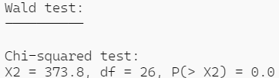
MODEL DIAGNOSTICS
Wald Test
Wald Test is used to check the significance of individual explanatory variables in Logistic Regression (similar to t-statistic in linear regression)
Wald Test statistic is a chi-square test statistic
Null Hypothesis Ho: Bi=0
Alternative Hypothesis H1: Bi≠0
Since, p-value is less then 0.001, hence we reject Ho that the all Bi=0.

Slide 17
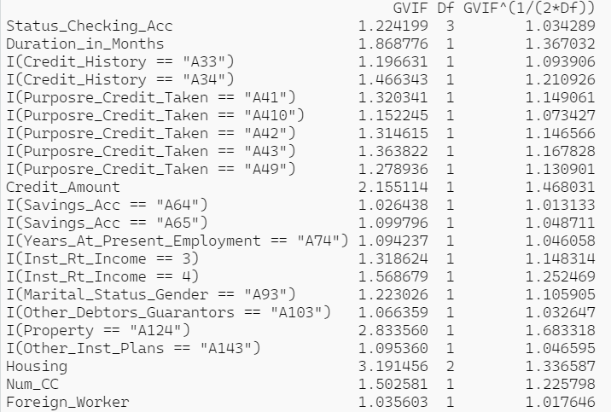
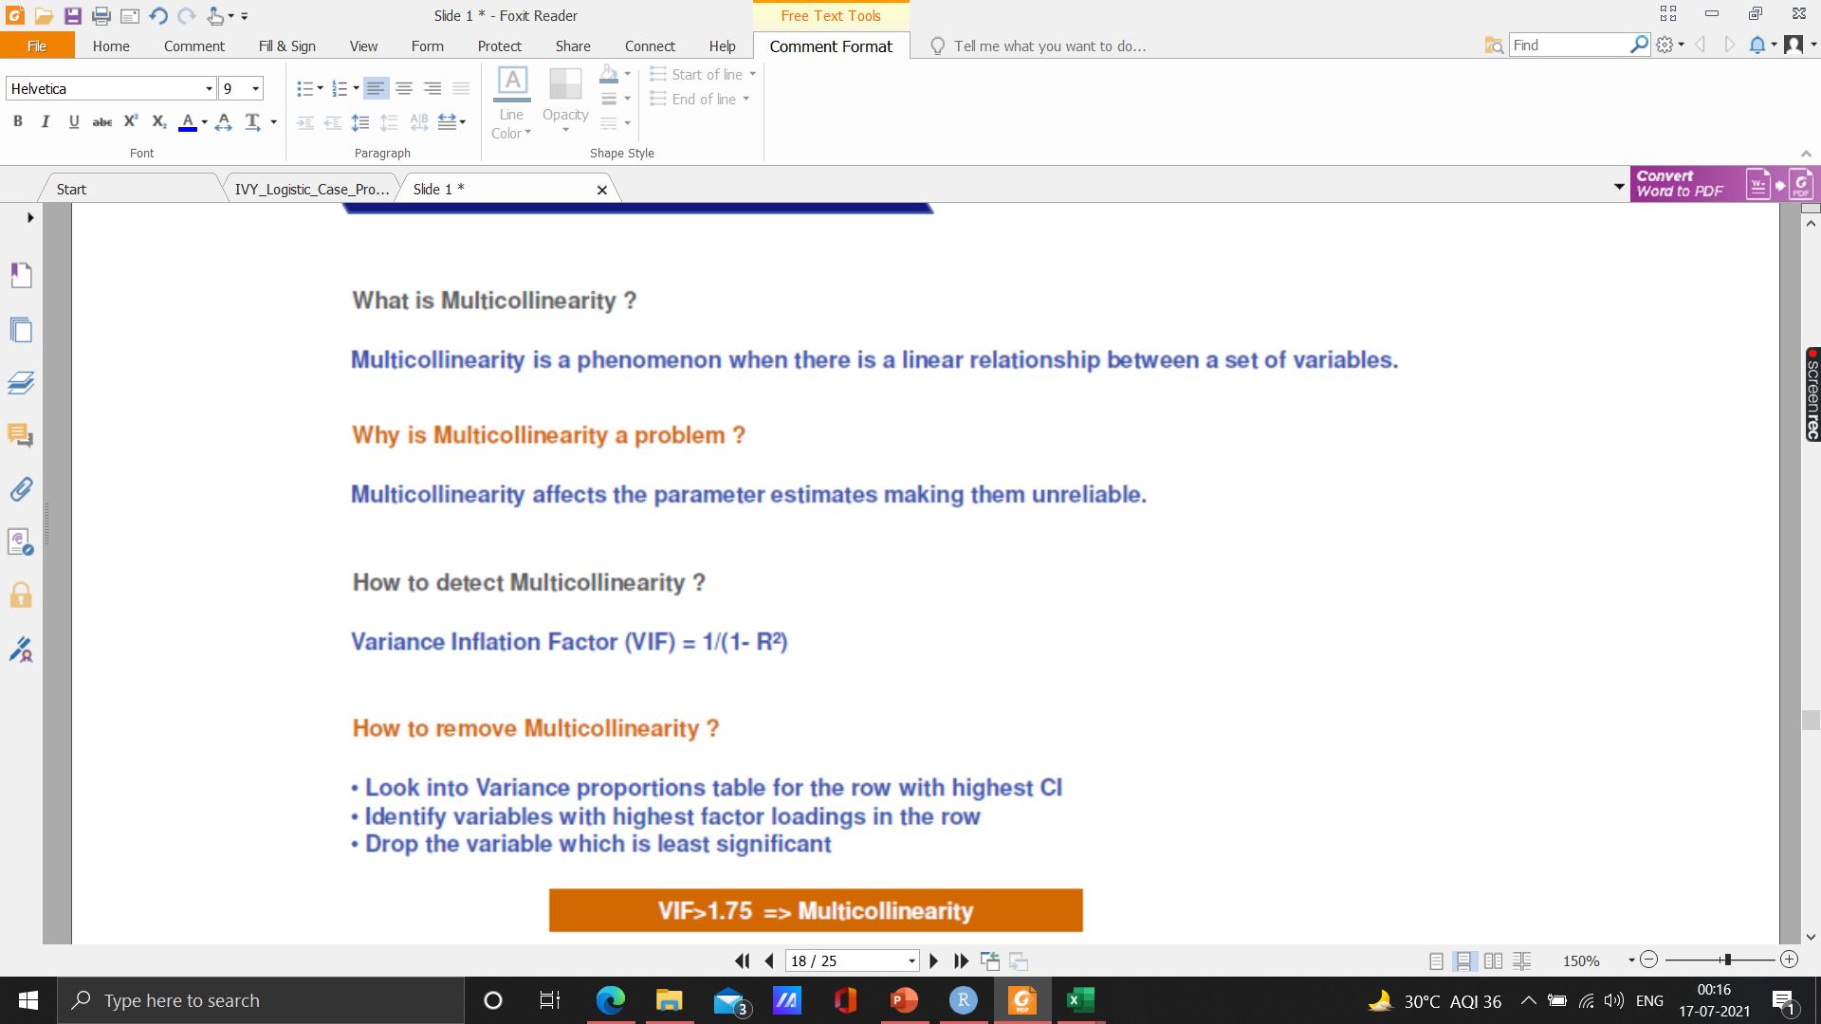
MODEL DIAGNOSTICS
VARIANCE INFLATION FACTOR
There is no problem of multicollinearity in the model since all the values are less than 1.7

Slide 18
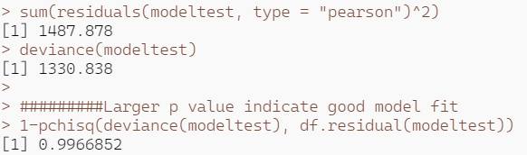
MODEL DIAGNOSTICS
Lackfit Deviance Test
Lackfit Deviance for assessing whether the model where
Ho: Observed Frequencies/probabilities =Expected Frequencies/probabilities
Larger p-value indicate good model fit
Thus, we accept the Null Hypothesis Ho that Observed Frequencies = Expected Frequencies

Slide 19
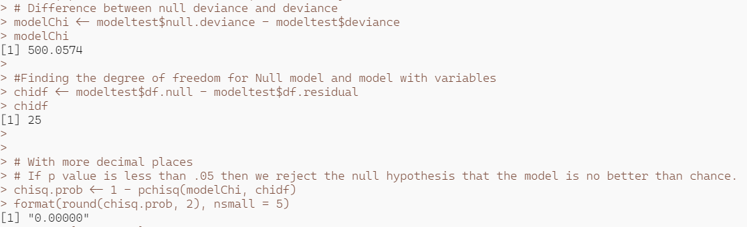
MODEL DIAGNOSTICS
Lagrange Multiplier or Score Test
Lagrange Multiplier or Score Test (Assess whether the current variable significantly improves the model fit or not).
Null Hypothesis: Null model = Baseline Model
Alternate Hypothesis: Null model <> Baseline Model
Null model will explain the 'y' less and actual model will explain the 'y' more
If p-value is less than 0.05 then we reject the null hypothesis that the model is no better than chance.
Here, null hypothesis is rejected as chi square probability is 0.0000 < 0.05

Slide 20
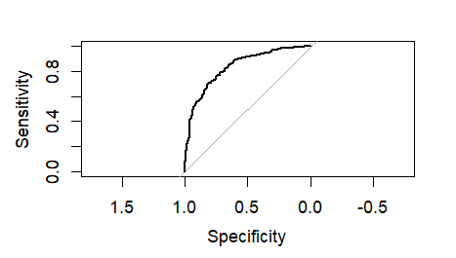
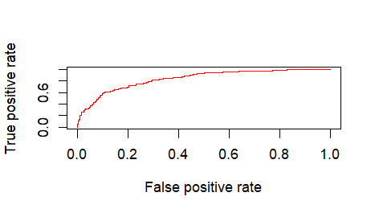
RECEIVER OPERATING CHARACTERISTICS (ROC) CURVE
ROC curve plots the true positive rate (right positive classification) against the false positive rate(1-specificity) and compares it with random classification.
The higher the area under the ROC curve, the better the prediction ability.
Area under the ROC(AUC) curve is interpreted as the probability that the model will rank a randomly chosen positive higher than randomly chosen negative.
The AUC-ROC curve is given below:
KS- statistics for the model is : 0.5179 which is well between 40-70% significance level.

Slide 21
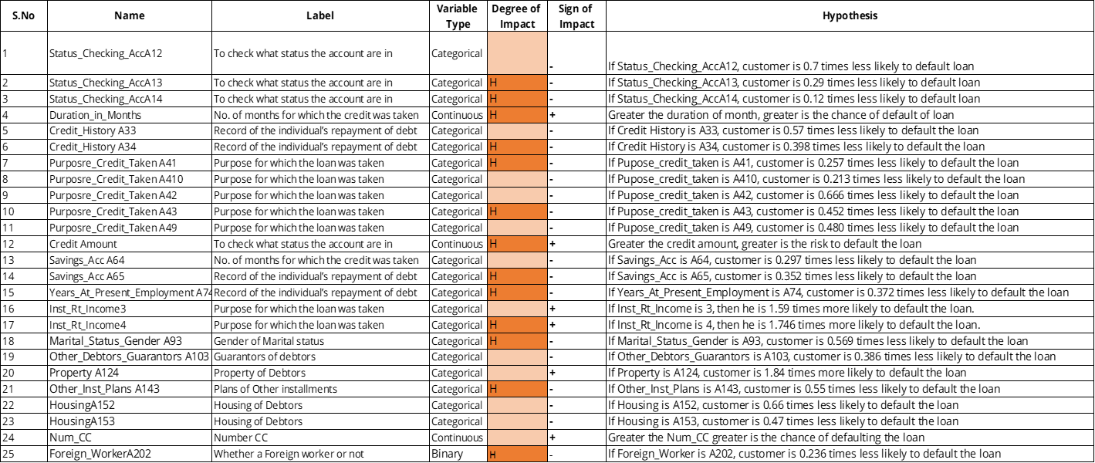
Business Hypothesis

Slide 22
THANK YOU

